Slide 1
One Care Data Presentation

Slide 2
Using Data to Drive Decisions
Why Data?
Removes values and beliefs from the information available to make decisions
Eliminates terminology gaps between public safety and public health
Removes “he said/she said” from projects
Considerations
Collection and standardization of process
Timeliness of analysis and dissemination
Effective public health and public safety collaboration
Translation of data to information and strategy

Slide 3
Data in the Technical Assistance Process
Assessment
Define the problem
Capacity
Align stakeholders
Activate community
Planning
Determine effective and efficient strategies to eliminate the problem
Implementation/Evaluation
Perform quality improvement
Evaluate program success/failure
Sustainability
Obtain grant funding (moving to next phase/temporary)
Build local, state, national support around the strategy
Facilitate third party payment strategies

Slide 4
Population Trend, 2014-2018
Virginia vs. One Care Service Area
2018 Total Virginia population: 8.52 million
2018 One Care service area population: 0.58 million
One Care service area represents 6.8% of the total Virginia population as of 2017.
Population of Virginia has increased 2.5% from 2014-2018.
Population of One Care service area has decreased 2% from 2014-2018.

Slide 5
Population by Age, 2017
USA, Virginia, vs. One Care Service Area
One Care service area has higher than national and state percent of population in the 15-24 age group (higher education) and 55+ age groups.

Slide 6
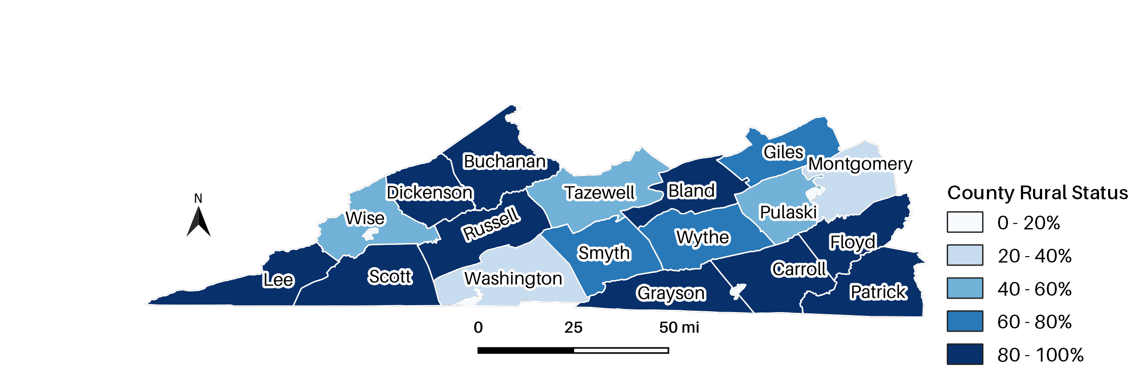
Population by Rural Status, 2018
One Care Service Area
Of the 22 counties in One Care’s service area:
68% have a primary care services shortage (15)
100% have a dental services shortage (22)
100% have a mental health services shortage (22)
68% are a Medically Underserved Area (15)

Slide 7
Population by Race, 2017
USA, Virginia, vs. One Care Service Area

Slide 8
Population by Poverty Status, 2017
USA, Virginia, vs. One Care Service Area
1 in 5 people in One Care’s service area lives below the federal poverty.
People in One Care’s service area have a 75 percent higher poverty incidence than that of Virginia.

Slide 9
Opioid Prescription Rates, 2013-2017
USA, Virginia, vs. One Care Service Area
One Care service area has a significantly higher opioid prescription rate.
Near the Virginia border, Kentucky, Tennessee, and West Virginia also have significantly higher than average opioid prescription rate.
In 2017, Galax and Norton cities had an opioid prescription rate over 6 times higher than Virginia and national averages.

Slide 10
Overdose Deaths, 2013-2017
One Care Service Area, All Drugs
One Care service area accounted for 11.6% of Virginia overdose deaths in 2013 and 7.6% in 2017.
9.4% (n=10) increase in overdose deaths from 2013-2017.
One Care service area’s overdose death rate is higher than Virginia, but the rate of increase is slower.

Slide 11
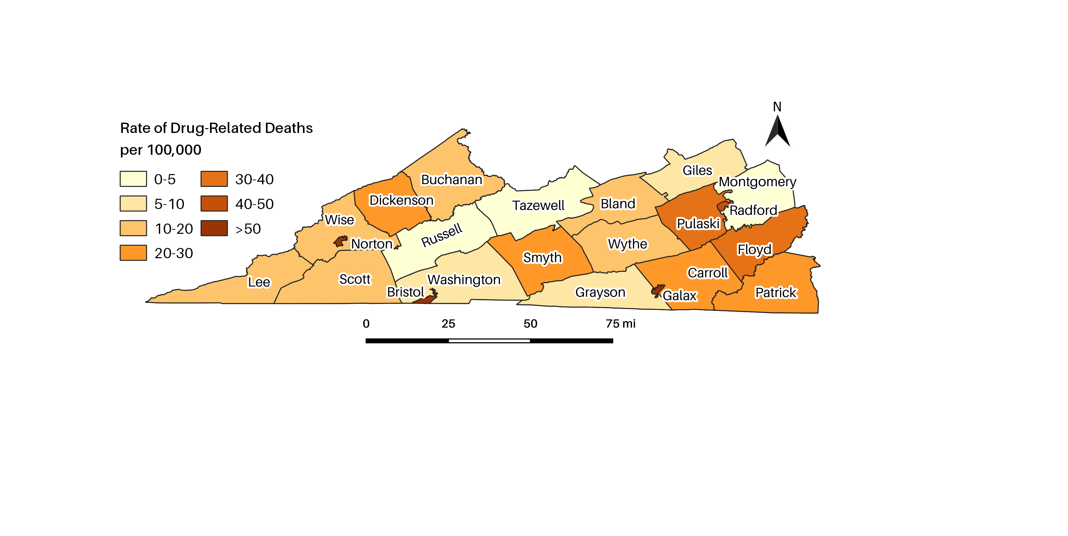
Overdose Deaths, 2013-2017
One Care Service Area, All Drugs

Slide 12
Overdose Deaths, 2013-2017
USA, Virginia, vs. One Care Service Area, All Opioids
Virginia experienced an 80% increase in opioid overdose deaths from 2013 to 2017.
One Care service area experienced a 1% increase in opioid overdose deaths from 2013 to 2017.

Slide 13
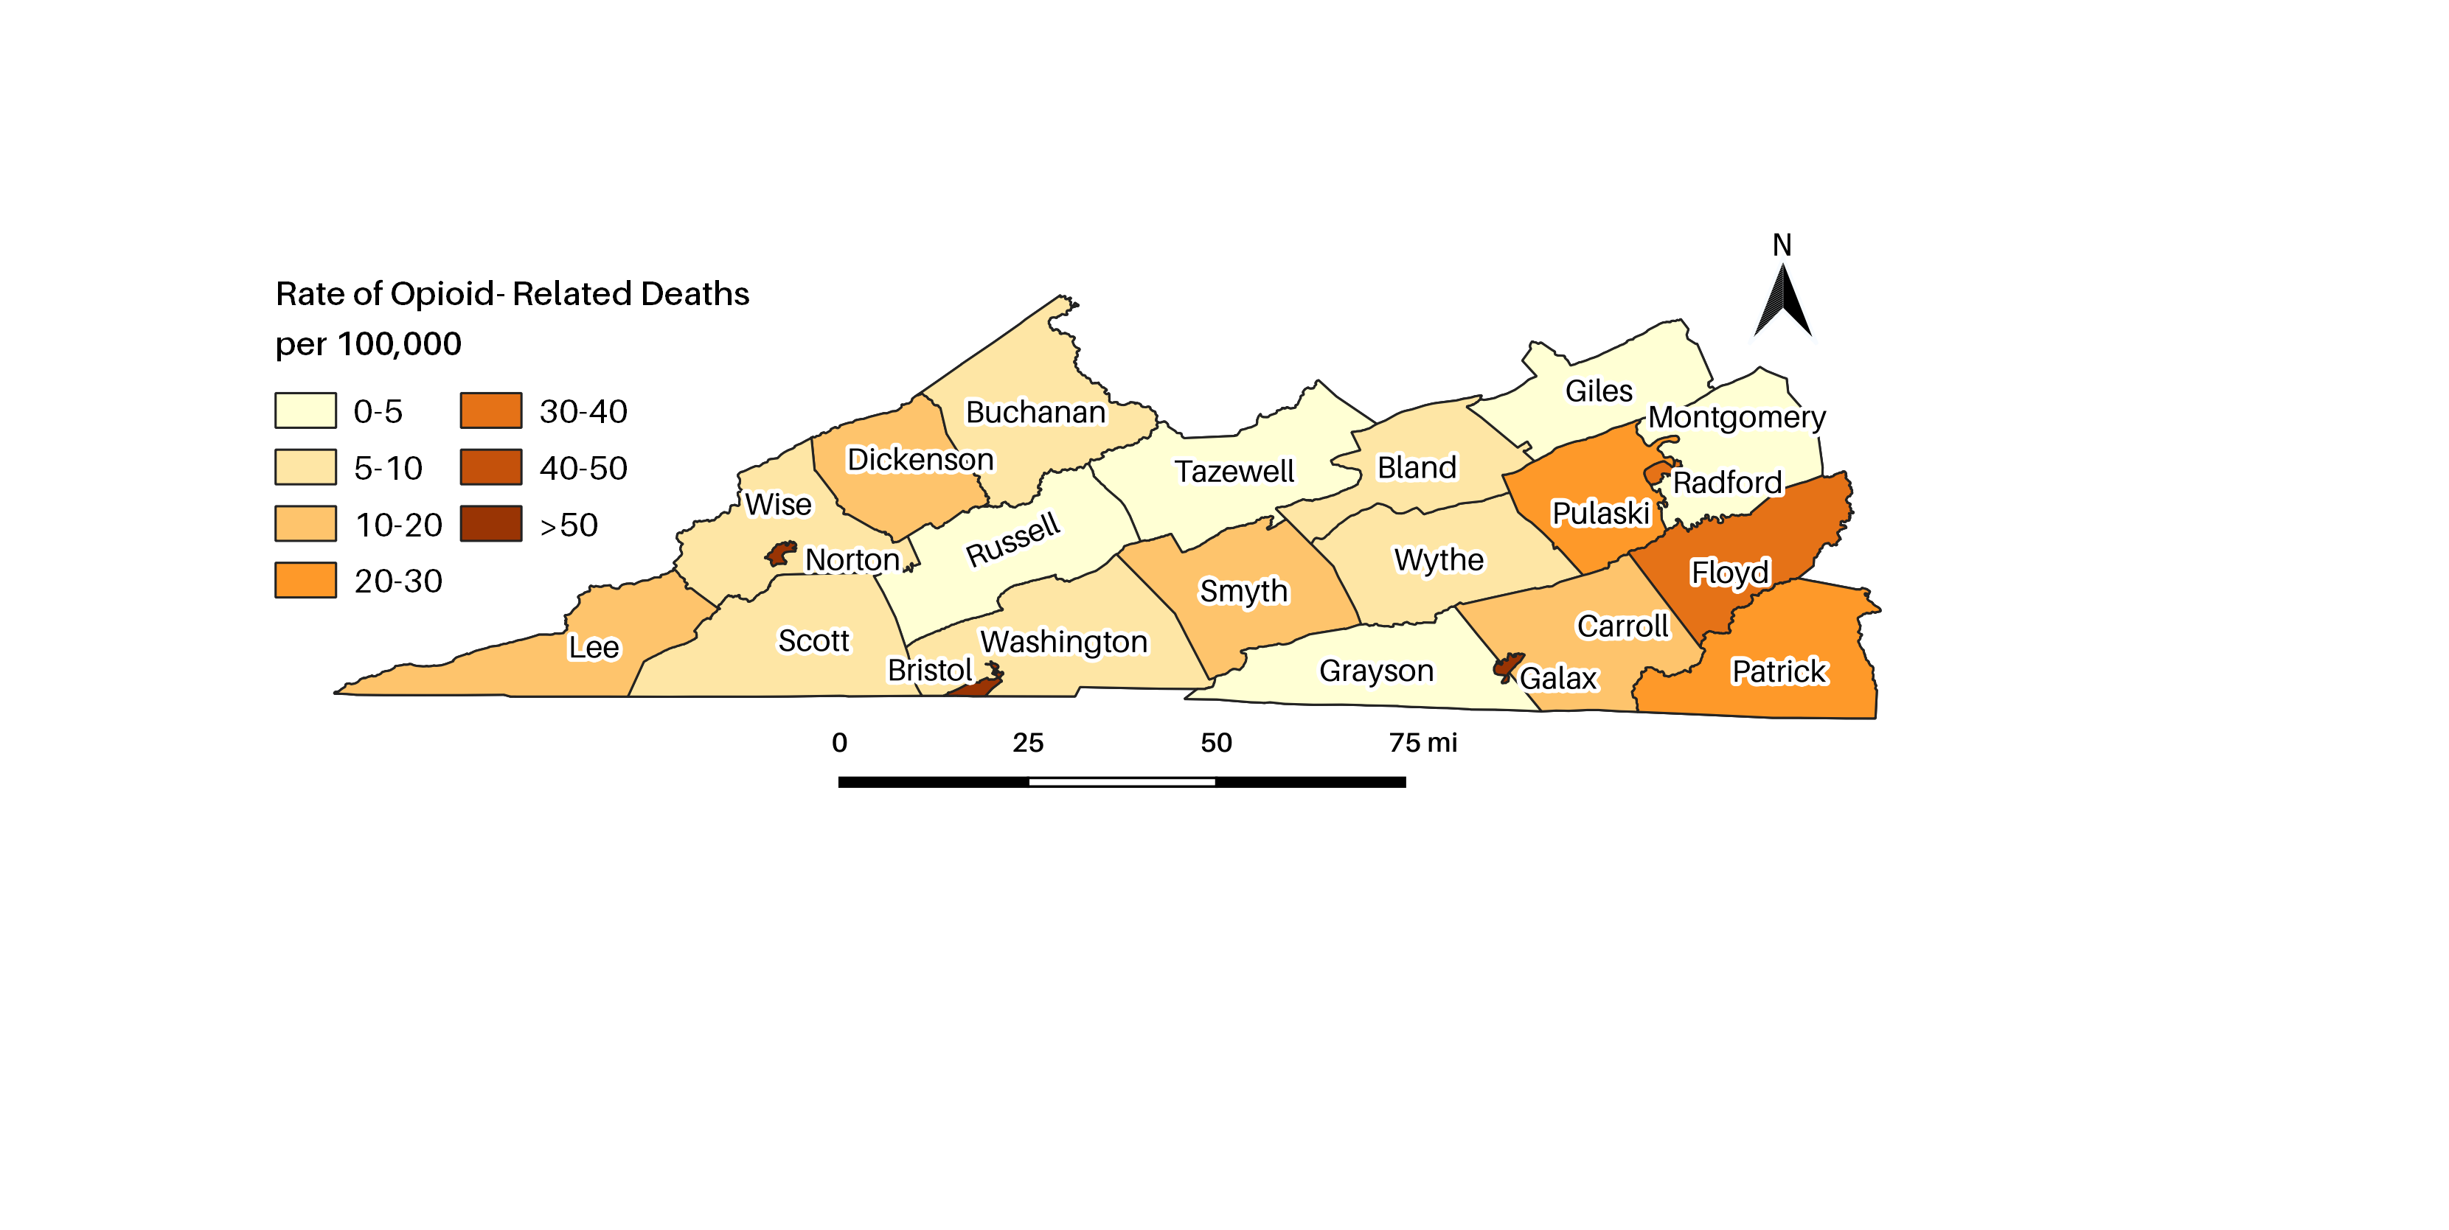
Overdose Deaths, 2013-2017
One Care Service Area, All Opioids

Slide 14
Overdose Deaths, 2013-2017
Virginia, Fentanyl and/or Heroin
Fentanyl alone OD death rate increased 300%.
Heroin alone OD death rate fell 25%.
Fentanyl + Heroin OD death rate increased 6600%.
Total Fentanyl and/or Heroin OD death rate increased 200%.

Slide 15
Overdose Deaths by Drug, 2013-2017
Virginia
Cocaine
73% increase
Fentanyl
450% increase
Heroin
57% increase
Prescription Opioids
34% decrease

Slide 16
Opioid Overdose Deaths by Age, 2013-2017
USA vs. Virginia

Slide 17
Overdose Deaths by Gender, 2017
USA, Surrounding States, vs. Virginia (ICD 10 Codes X40-X44)

Slide 18
Overdose Deaths by Race, 2017
Virginia, Percent of Population vs. Percent of Overdose Deaths

Slide 19
EMS Naloxone Administered, 2013-2017
Virginia vs. One Care Service Area Averages
One Care regions have a 108% increase in EMS Naloxone 2013-2017
Virginia has a 227% increase in EMS Naloxone 2013-2017

Slide 20
EMS Naloxone Administered, 2017
USA vs. Virginia

Slide 21
EMS Naloxone Administered, 2013-2017
Virginia vs. One Care Service Area Averages

Slide 22
Hepatitis C Incidence, 2013-2017
Virginia vs. One Care Service Area Averages, 18-30 Year Olds

Slide 23
Neonatal Abstinence Syndrome, 2013-2016
Virginia vs. One Care Service Area Averages

Slide 24
Drug Arrests, 2013-2017
USA vs. Virginia
Virginia Drug Arrests have increased 30% from 2015-2017, compared to an 8% increase for the USA.

Slide 25
References
Centers for Disease Control and Prevention, National Center for Health Statistics. Underlying Cause of Death 1999-2017 on CDC WONDER Online Database, released December, 2018. Data are from the Multiple Cause of Death Files, 1999-2017, as compiled from data provided by the 57 vital statistics jurisdictions through the Vital Statistics Cooperative Program.
Virginia Department of Health. (n.d.). Retrieved from http://www.vdh.virginia.gov/data/opioid-overdose/
Cash RE, Kinsman J, Crowe RP, Rivard MK, Faul M, Panchal AR. Naloxone Administration Frequency During Emergency Medical Service Events — United States, 2012–2016. MMWR Morb Mortal Wkly Rep 2018;67:850–853. DOI: http://dx.doi.org/10.15585/mmwr.mm6731a2External.
Source: U.S. Census Bureau, Population Division Release Dates: For the United States, regions, divisions, states, and Puerto Rico Commonwealth, December 2017. For counties, municipios, metropolitan statistical areas, micropolitan statistical areas, metropolitan divisions, and combined statistical areas, March 2018. For cities and towns (incorporated places and minor civil divisions), May 2018.

